Slide 1




Employee Attrition Predictor
Meera Krishnakumar
V Raghav Anand
Parvathy AJ
S. Sai Sreelekha
P. Sri Sneha Karthika

Slide 2


Introduction
Companies invest a lot of time and resources in employee recruitment and training.
When an employee leaves a company, the organization not only losing its time but also resources and must recruit their replacement which implies that they must again invest time and resources.
Training a new employee takes a lot of time and its costly

Slide 3


What is it?
Employee Attrition is a natural process by which employees leave the work force.
Here we predict whether this employee attrition based on the given inputs like satisfaction level, number of projects, working hours, salary, , promotions etc.,
Using these parameters, we can predict whether the employee will stay or leave the company.

Slide 4

Advantages
Employee attrition prediction uses machine learning models to predict what employees are predicted to leave the company.
This helps us to predict employee attribution so that they can have a strategy to reduce this problem.

Slide 5

Comparison
Before
We do not know which employee will leave the organization .
So, it effects the organization's time and resources.
We may even lose our best employee without knowing.
After
We can predict whether the employee is satisfied with our organization or not.
If not, we can use some statics like increasing salary , promotion etc., to keep them in the organization .

Slide 6

Disadvantages
There are some reasons we cannot avoid the employee to leave the organization.
We also have some employees who must transfer so they will have to leave the company effective immediately though they are satisfied with their job.

Slide 7
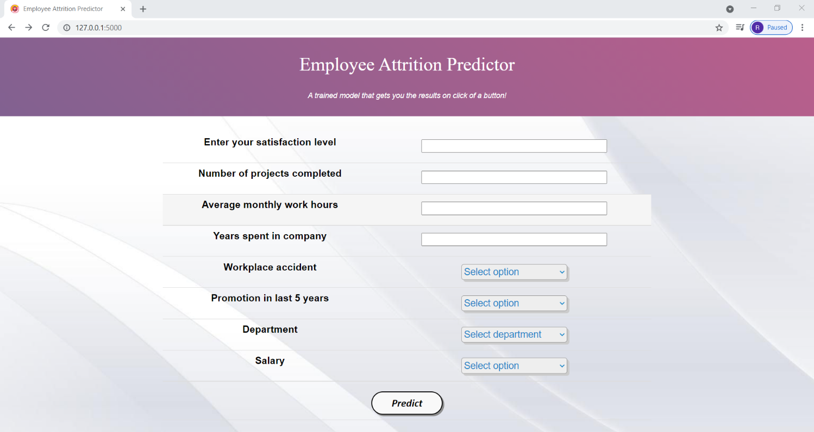
User Interface

Slide 8
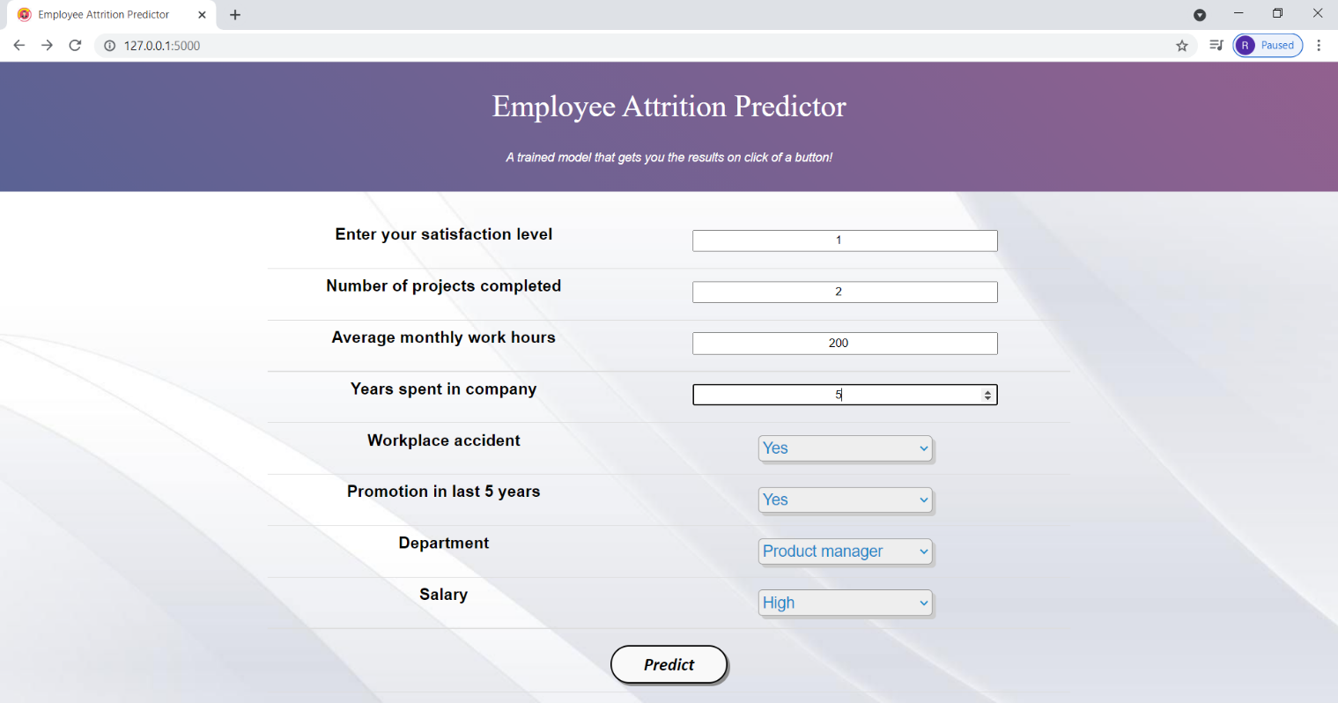
FILLING THE FORM IN SUCH A WAY THAT THE PREDICTION SAYS THE EMPLOYEE WON’T LEAVE THE COMPANY:

Slide 9
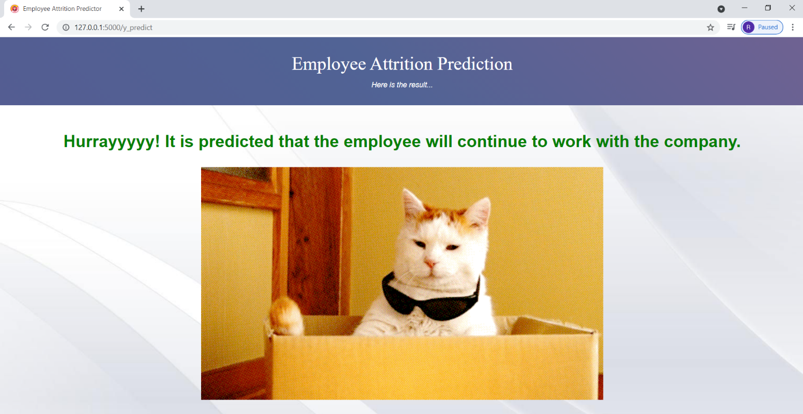
PREDICTION OBTAINED AFTER CLICKING THE PREDICT BUTTON:

Slide 10
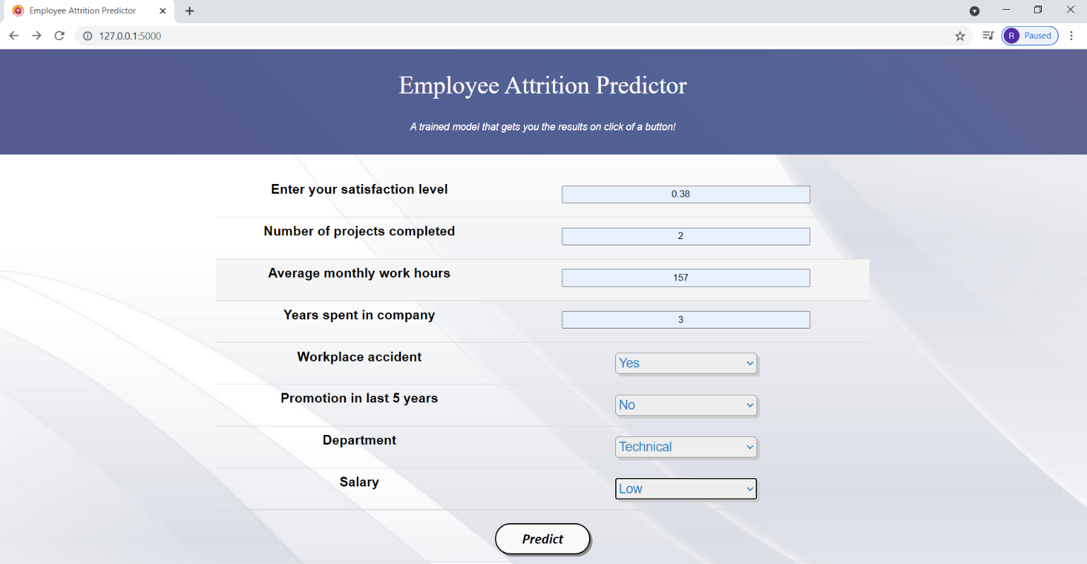
FILLING THE FORM IN SUCH A WAY THAT THE PREDICTION SAYS THE EMPLOYEE WILL LEAVE THE COMPANY:

Slide 11
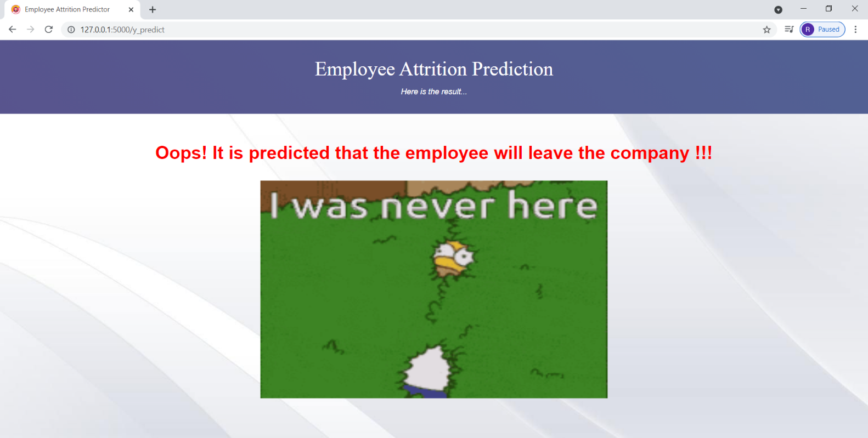
PREDICTION OBTAINED AFTER CLICKING THE PREDICT BUTTON:

Slide 12


Conclusion
Using Emplyee Attrition predictor, we can predict whether the employee stays in the organization or not using some parameters.
On the contrary, we cannot predict that the satified employee or the employee that wants to stay may have to quit the organization due to some other reasons.
We cannot be so sure that employee will permantly stay or will leave the organization.
By using this predictor, we may not avoid the employee attrition completely but to maximum extent we can prevent them.

Slide 13


